Slide 1
Thermo-Mechanics
NE 591

Slide 2
Last Time
Solid mechanics predicts the deformation of a body from its applied load
The strain defines the deformation
The stress defines the material’s internal response to the strain
Materials can have recoverable and permanent deformation
Elastic deformation is recoverable and occurs due to the stretching of the atomic lattice
Plastic deformation is permanent and results form the breaking of bonds during dislocation (line defect) migration
We derived two analytical solutions for the stress in a pressurized cylinder
Thin walled cylinder
Any size wall

Slide 3
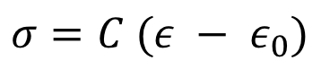
Thermal Expansion
As the temperature increases, atoms have larger vibrations, causing the material to expand
This expansion doesn’t raise the energy of the material when unrestrained
This expansion can be treated as a strain, but as one that doesn’t cause stress
$σ=C (ε − ε_{0})$

Slide 4
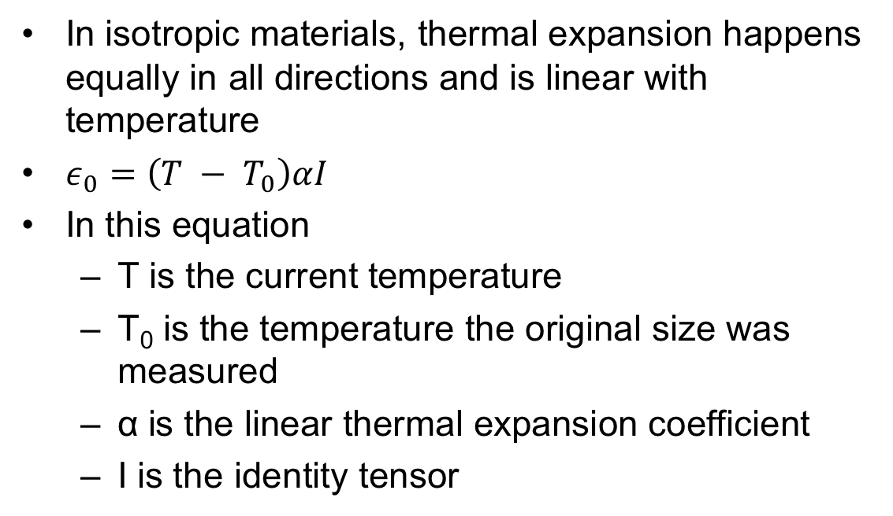
Thermal Expansion
In isotropic materials, thermal expansion happens equally in all directions and is linear with temperature
$ε_{0}=\left(T − T_{0}\right)αI$
In this equation
T is the current temperature
T₀ is the temperature the original size was measured
α is the linear thermal expansion coefficient
I is the identity tensor

Slide 5
Thermal Expansion
Though thermal expansion doesn’t directly cause stress, it can still lead to thermal stress

Slide 6
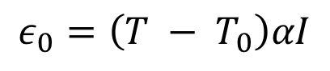
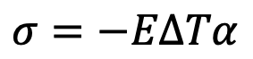
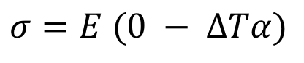
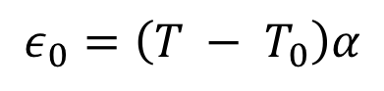
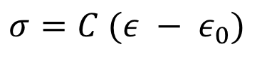
What is the stress in a thin constrained rod of length L when it is heated to ΔT?
The rod has a Young’s modulus of E and an expansion coefficient of α
$$ε_{0}=\left(T − T_{0}\right)αI$$
$σ=C (ε − ε_{0})$
$$ε_{0}=\left(T − T_{0}\right)α$$
$σ=E (0 − ΔTα)$
$σ=−EΔTα$

Slide 7
The large temperature gradient within a fuel pellet results in large thermal stresses

Slide 8
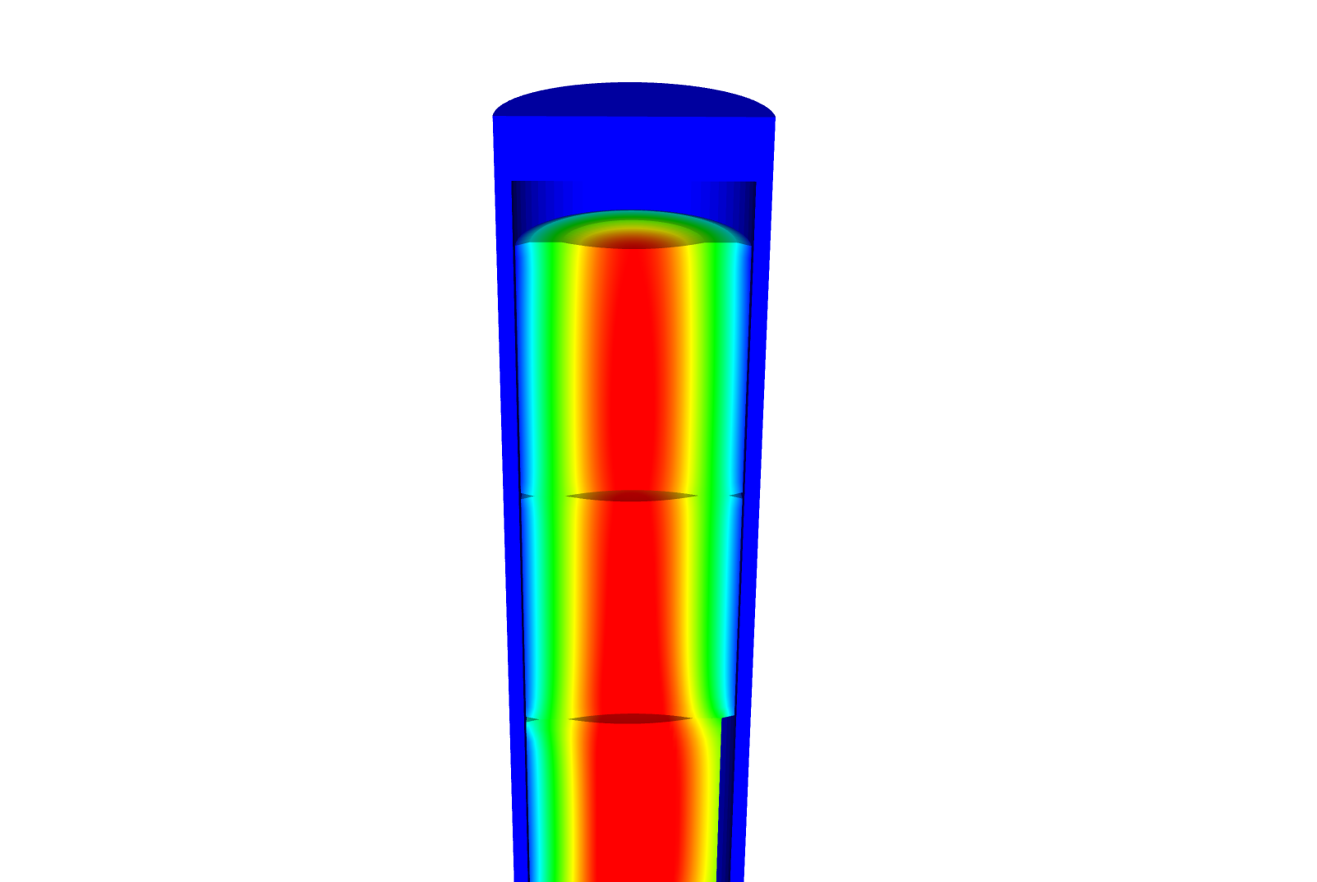
Consider the material response of the axisymmetric body
We assume small strains, so the strain is defined as
We assume isotropic material response, so

Slide 9
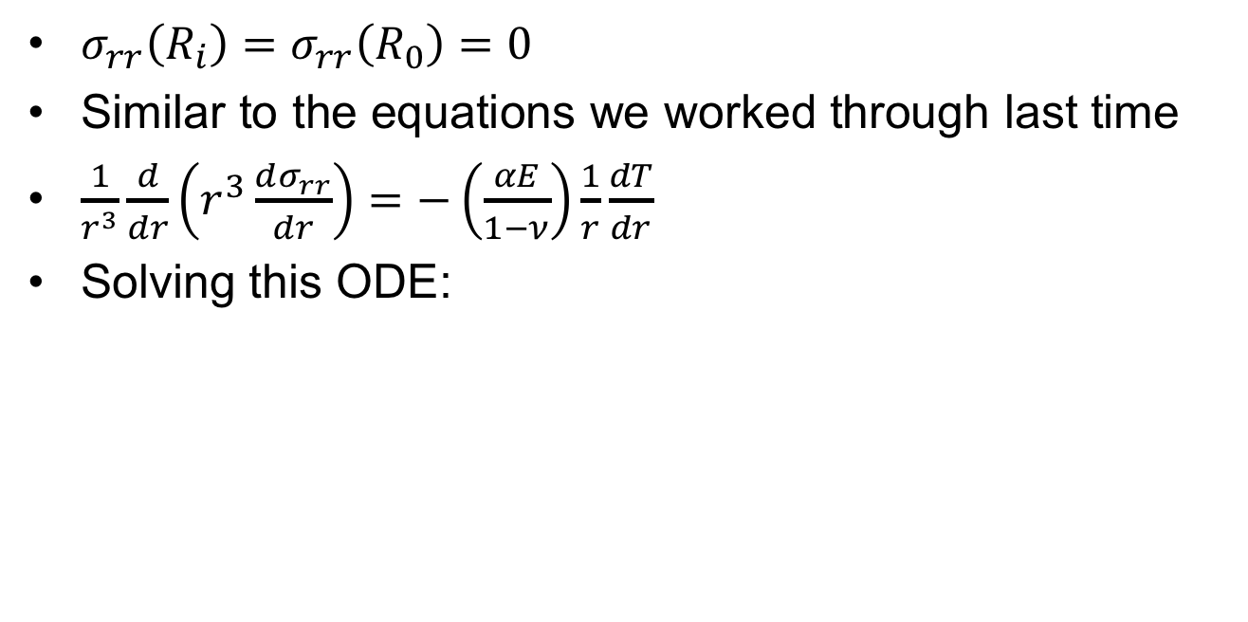
Consider a cylinder with thermal expansion but not pressure
$σ_{rr}\left(R_{i}\right)=σ_{rr}\left(R_{0}\right)=0$
Similar to the equations we worked through last time
$\frac{1}{r^{3}}\frac{d}{dr}\left(r^{3}\frac{dσ_{rr}}{dr}\right)=−\left(\frac{αE}{1−ν}\right)\frac{1}{r}\frac{dT}{dr}$
Solving this ODE:

Slide 10
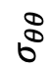
What is the hoop stress in the cladding?
$$σ_{θθ}$$
r
R_{i}
R_{f}

Slide 11
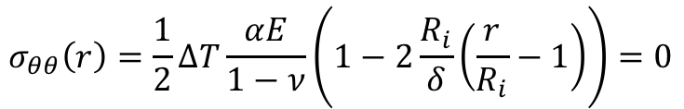
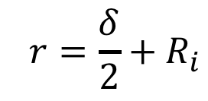
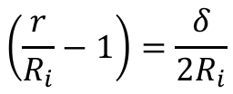
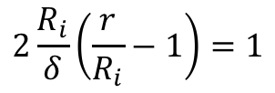
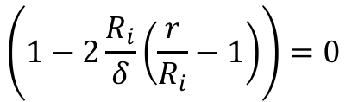
Where is hoop stress equal to zero?
$$σ_{θθ}\left(r\right)=\frac{1}{2}ΔT\frac{αE}{1−ν}\left(1−2\frac{R_{i}}{δ}\left(\frac{r}{R_{i}}−1\right)\right)=0$$
$$\left(1−2\frac{R_{i}}{δ}\left(\frac{r}{R_{i}}−1\right)\right)=0$$
$$\left.2\frac{R_{i}}{δ}\left(\frac{r}{R_{i}}−1\right)\right.=1$$
$$\left.\left(\frac{r}{R_{i}}−1\right)\right.=\frac{δ}{{2R}_{i}}$$
$$\left. r\right.=\frac{δ}{2}+R_{i}$$

Slide 12
The linear temperature gradient across the cladding causes axial thermal stresses

Slide 13
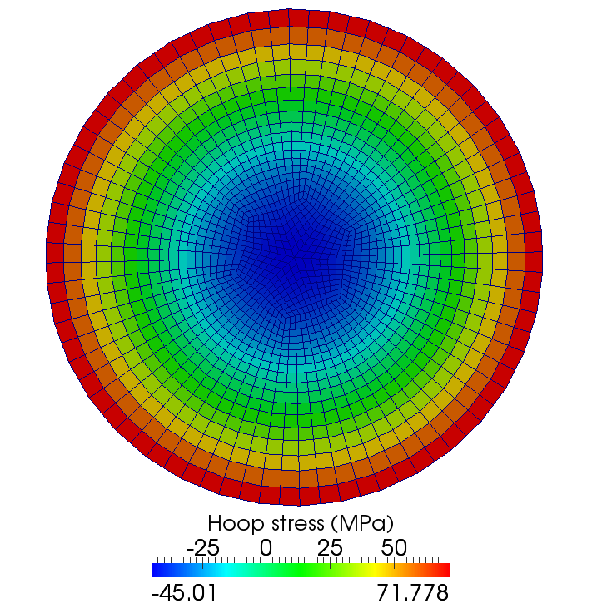
Same approach to the thermal stress in a fuel pellet
The thermal stress is due to the temperature gradient

Slide 14
Solve this stress ODE
The boundary conditions are:
Once we solve it, we obtain
Then we can solve the hoop stress
The axial stress is much more complicated to obtain, but you end up with

Slide 15
The fuel temperature gradient causes large thermal stresses

Slide 16
How far do fuel cracks extend?
E = 200 GPa, ν = 0.345, α = 11.0e-6 1/K, σ_{fr} = 130 MPa, ΔT = 550 K
Solve for η
– σ_{fr} / σ* = 1 – 3 η²
3 η² = 1 + σ_{fr} / σ*
η = ( (1 + σ_{fr} / σ*)/3 )^{½}
σ* = 11.0e-6*200*550/(4*(1 – 0.345) ) = 461.8 MPa
η = sqrt( (1 + 130/461.8)/3 ) = 0.65

Slide 17
Analytical Thermomechanics Summary
Increases in temperature cause most materials to expand
We call this thermal expansion, which is a strain that doesn’t inherently cause stress
Thermal expansion can cause stress when
Deformation is constrained
There are gradients in the expansion coefficient
There is a temperature gradient
We have analytical equations for thermal stresses in the cladding and in the fuel

Slide 18
The gap changes as a function of time
Both the pellet and the cladding swell
But, as the gap decreases, the temperature changes, which again makes the gap change
The solution using the analytical equations is iterative, due to the dependence of the gap size and temperature.

Slide 19
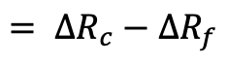
Calculate the steady state temperature profile in the rod, including thermal expansion
LHR = 200 W/cm, δ⁰_{gap} = 30 μm, R_{f} = 0.5, T_{cool} = 580 K, T_{EXP,0} = 373 K, k_{gap} = 0.0026 W/cm-K, t_{C}= 0.06 cm, α_{f} = 11.0e-6 1/K, α_{C} = 7.1e-6 1/K
ΔT_{cool} = 25.5 K, ΔT_{clad} = 22.5 K, ΔT_{fuel} = 530.5 K
So, T_{IC} = 580 + 25.5 + 22.5 = 628.0 K, T_{s} = 701.5 K, T₀ = 1232.0 K
First, we will deal with expansion in the cladding
Av(R_{c}) = 0.5 + 30e-4 + 0.06/2 = 0.533 cm
Av(T_{C}) = 580 + 25.5 + 22.5/2 = 616.75 K
ΔR_{c} = 0.533*7.1e-6*(616.75 – 373) = 9.22e-4 cm
$$= ΔR_{c}−ΔR_{f}$$

Slide 20
Calculate the steady state temperature profile in the rod, including thermal expansion
Second, we deal with the fuel
Av(Tf) = (1232 + 701.5)/2 = 966.7 K
ΔR_{f} = 0.5*11e-6*(966.7 – 373) = 0.0033 cm
The total change in the gap is 9.22e-4 – 0.0033 = -0.0023
However, that means the gap is smaller and so our temperatures were wrong!

Slide 21
This calculation is repeated until the gap width stops changing significantly
The change in the gap does NOT effect the coolant or cladding temperatures, just the gap and fuel temperatures.
We only need to repeat the calculation of the fuel and cladding temperatures and the change in the gap
Iteration | δ_{gap} (cm) | T_{s} (K) | T₀ (K)
0 | 0.003 | 701 | 1232
1 | 0.00066 | 644 | 1174
2 | 0.00097 | 652 | 1182
3 | 0.00094 | 651 | 1181
4 | 0.00094 | 651 | 1181

Slide 22
Next time
Solve the temperature and the displacement vector for the full thermomechanical problem

